Slide 1

myCompiler: Your Cloud-Based IDE
myCompiler is a versatile online IDE. It supports numerous programming languages. Run code, save projects, and access guides.
Notes:
1

Slide 2





Extensive Language Support
Web Development
Backend & Systems
Databases & Scripting
JavaScript, NodeJS, TypeScript, PHP, Deno
Python, Ruby, Go, C, C++, Java, C#, Rust, Assembly
SQL, MySQL, MongoDB, Bash, Perl
Scientific & Niche
R, Octave (MATLAB), Fortran, Lua, Erlang, Clojure, D, Kotlin, Swift
Notes:
2

Slide 3


Core Functionality
1
Run Code
Execute your programs instantly in the cloud.
2
Save Projects
Store your work securely for future access.
3
Program Input
Provide custom inputs for your code execution.
4
Output Display
View results and debug information clearly.
Notes:
3

Slide 4
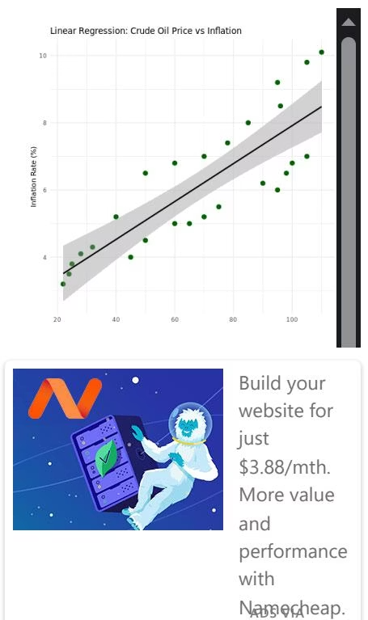
Example: R Data Analysis
myCompiler supports complex R scripts. This example analyzes crude oil prices and inflation. It demonstrates data manipulation and plotting.
The platform handles statistical modeling. It provides detailed regression summaries.
Notes:
4

Slide 5
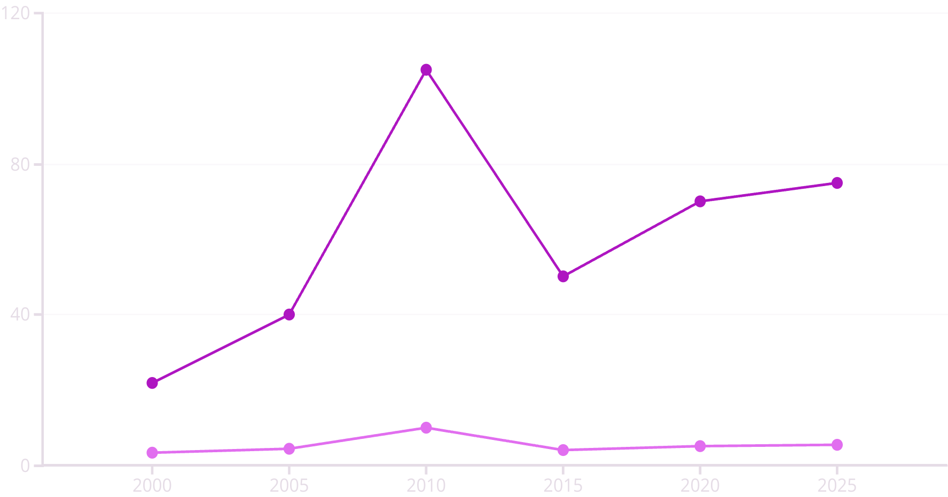
Crude Oil vs. Inflation Trends
Crude Oil Price ($/bbl)
Inflation Rate (%)
This chart visualizes the relationship between crude oil prices and inflation. It shows how these economic indicators fluctuate over time.
Notes:
5

Slide 6
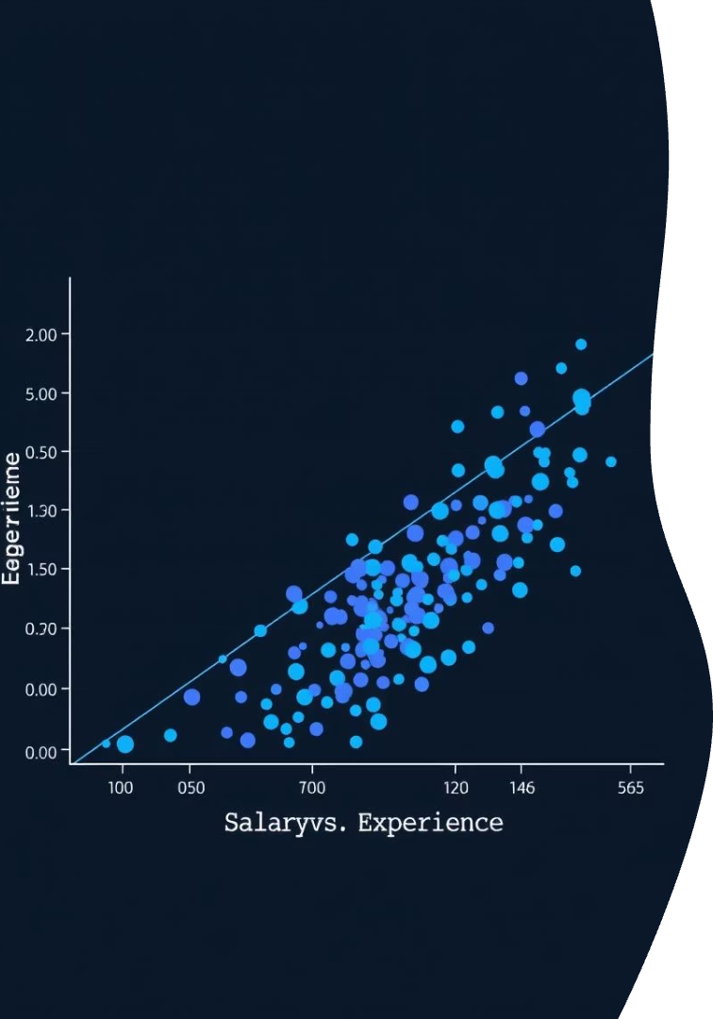
Regression Analysis Insights
Model Summary
Coefficients
The linear regression model shows a positive relationship. Crude oil price influences inflation.
Intercept: 2.268683. Crude oil price coefficient: 0.056466.
R-squared
Multiple R-squared: 0.70. This indicates a strong fit.
Notes:
6

Slide 7
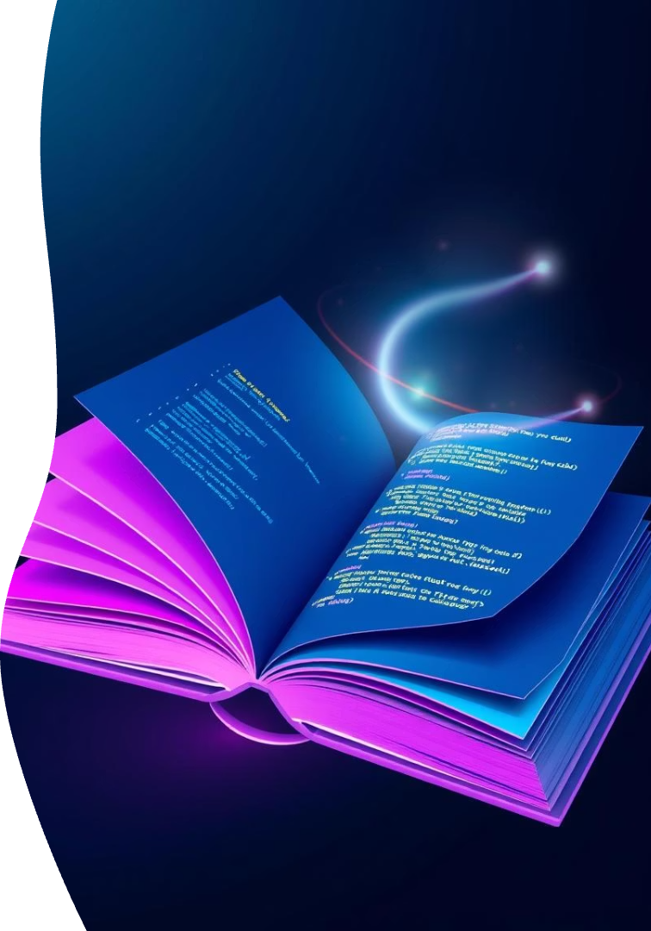



Learning Resources
Programming Guides
Access comprehensive guides for various languages.
Tutorials
Learn new concepts with step-by-step instructions.
Code Examples
Explore practical code snippets for inspiration.
Notes:
7

Slide 8

Legal & Contact Information
1
Terms of Service
Review our user agreements and policies.
Read More
2
Privacy Policy
Understand how we protect your data.
Read More
3
Contact Us
Reach out for support or inquiries.
Get in Touch
Notes:
8

